Slide 1
Primary hyperlipedemias
Dr.Rakesh k
SR Cardiology

Slide 2
Primary hyperlipidemias
Introduction & Importance
Overview on lipid metabolism
Primary hyperlipidemias
Management

Slide 5
INTERHEART Study
Attributable Risk Factors
for a First Myocardial Infarction
100
90
80
60
50
PAR (%)
40
36
33
18
20
20
14
12
10
7
0
Smoking
Fruits/ Veg
Exercise
Alcohol
Hyper- tension
Diabetes
Abdominal
obesity
Psycho- social
Lipids
All 9 risk factors
Lifestyle factors
Notes:
In this study of 15,152 patients, lipids had the highest population attributable risk for a first myocardial infarction among 9 risk factors for cardiovascular disease.

Slide 7
Atherosclerosis and dyslipidemia have a very close association.
All the cardiovascular risk models advocate lipoprotein studies in risk stratification and prognostication
Recently, non – HDL fraction, apo B , ratio of apo B to apo A 1, number and size of small, dense LDL particles are all emerging as risk markers for CAD.
Lp(a) also emerging as an important risk factor of CAD
Subendothelial retention of LDL -initiating factor for atherosclerotic plaque formation

Slide 8
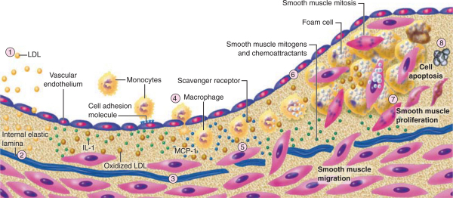

Slide 9
Some other observations and their importance
Familial combined hyperlipidemia (FCHL) is estimated to occur in approximately 1 in 100–200 individuals and is an important cause of premature CHD.
Approximately 20% of patients who develop CHD under age 60 have FCHL.

Slide 10
It has been estimated that at least 50% of variation in LDL-C is genetically determined. (polygenic/single gene)
The population frequency of heterozygous FH due to LDL receptor mutations is as high as approximately 1 in 250 individuals.
Untreated men with heterozygous FH have an ~50% chance of having a MI before age 60 years, and women with heterozygous FH are at substantially increased risk as well.

Slide 11
Terminology
Hyperlipidemia-Concentration of lipid in the blood exceeds the upper range of normal in a 12 hr fasting blood sample.
Dyslipidemia -reflect disorders of the lipid transport pathways associated with arterial disease more appropriately than does the term hyperlipidemia.

Slide 12
Lipid structure and metabolism
Lipids constitute approximately 70% (by mass) of the dry weight of plasma.
Approximately half of circulating lipids are sterols, with the other major components being phospholipids and triglycerides, which circulate in lipoproteins.

Slide 13
Lipoprotein structure
Lipoproteins are large macromolecular complexes composed of lipids and proteins.
Notes:
Here is a diagramatic representation of a lipoprotein.
Plasma lipoproteins are spherical particles containing a hydrophobic core composed predominately of triglyceride and / or cholesterol esters and a surface coat whose primary component is a phopholipid monolayer. Interspersed in the phopholipid coat are free cholesterol and apolipoproteins.
(Apoproteins are the protein portion of the lipoproteins)

Slide 14
Lipoproteins – physiological functions
Absorption of
- dietary cholesterol
- long-chain fatty acids
- fat-soluble vitamins
Transport & exchange of
- triglycerides
- cholesterol
- fat-soluble vitamins

Slide 18
Apolipoprotein classes

Slide 19
Apolipoproteins - functions
Structural proteins in lipoproteins.
Negotiate the hydrophobic, insoluble lipids in plasma.
They activate enzymes in lipoprotein metabolism.
Act as ligands for cell surface receptors.

Slide 20
The normal lipid physiology

Slide 21
Transport of Intestinally Derived Dietary Lipids by Chylomicrons
Dietary triglycerides are hydrolyzed by lipases within the intestinal lumen and emulsified with bile acids to form micelles.
Dietary cholesterol, fatty acids, and fat-soluble vitamins are absorbed in the proximal small intestine.
Cholesterol is esterified by the addition of a fatty acid in the enterocyte to form cholesteryl esters.
Longer-chain fatty acids (>12 carbons) are incorporated into triglycerides and packaged with apoB-48, cholesteryl esters, retinyl esters, phospholipids, and cholesterol to form chylomicrons.
Nascent chylomicrons are secreted into the intestinal lymph and delivered via the thoracic duct directly to the systemic circulation.

Slide 22
In periphery chylomicrons are extensively processed by peripheral tissues before reaching the liver.
The particles encounter lipoprotein lipase (LPL), which is anchored to a protein( GPIHBP1) that is attached to the endothelial surfaces of capillaries in adipose tissue, heart, and skeletal muscle.
The triglycerides of chylomicrons are hydrolyzed by LPL, and free fatty acids are released.
ApoC-II, which is transferred to circulating chylomicrons from HDL, acts as a required cofactor for LPL in this reaction.
The released free fatty acids are taken up by adjacent myocytes or adipocytes and either oxidized to generate energy or reesterified and stored as triglyceride.
The chylomicron particle progressively shrinks in size as the hydrophobic core is hydrolyzed and the hydrophilic lipids (cholesterol and phospholipids) and apolipoproteins on the particle surface are transferred to HDL, creating chylomicron remnants.

Slide 23
Chylomicron remnants are rapidly removed from the circulation by the liver through a process that requires apoE as a ligand for receptors in the liver.
So no chylomicrons or chylomicron remnants are generally present in the blood after a 12-h fast, except in patients with certain disorders of lipoprotein metabolism.

Slide 24
Transport of Hepatically Derived Lipids by VLDL and LDL
VLDL particles resemble chylomicrons in protein composition but contain apoB-100 rather than apoB-48 and have a higher ratio of cholesterol to triglyceride (~1 :5).
The packaging of the nascent VLDL particle requires the action of the enzyme microsomal triglyceride transfer protein (MTP).
After secretion into the plasma,VLDL acquires multiple copies of apoE and apolipoproteins of the C series by transfer from HDL.
As with chylomicrons, the triglycerides of VLDL are hydrolyzed by LPL, especially in muscle, heart, and adipose tissue.

Slide 25
After the VLDL remnants dissociate from LPL, they are referred to as IDLs, which contain roughly similar amounts of cholesterol and triglyceride.
The liver removes approximately 40–60% of IDL by LDL receptor–mediated endocytosis via binding to apoE.
The remainder of IDL is remodeled by hepatic lipase (HL) to form LDL.
During this process, phospholipids and triglyceride in the particle are hydrolyzed, and all apolipoproteins except apoB-100 are transferred to other lipoproteins.
Approximately 70% of LDL is removed from the circulation by the liver in a similar manner as IDL; however, in this case, apoB, rather than apoE, binds the LDL receptor.

Slide 27
HDL Metabolism and Reverse Cholesterol Transport
Reverse cholesterol transport-It is done by HDL
Nascent HDL particles are synthesized by the intestine and the liver.
In nascent HDL the efflux of phospholipids and unesterified cholesterol is promoted by the membrane protein ATP-binding cassette protein A1 &G1 (ABCA1 & ABCG1).
HDL particle acquire cholesterol, and is esterified by lecithin cholesterol acyl transferase (LCAT) a plasma enzyme associated with HDL.
HDL transfer cholesterol and triglycerides between VLDL,IDL through cholesteryl ester transfer protein (CEPT).
HDL cholesterol is taken up directly by hepatocytes via the scavenger receptor class B1 (SR-B1)
In the liver, cholesterol is secreted into the bile, either directly or after conversion to bile acids.

Slide 30
Classification - hyperlipidemia
Primary -defect in genes and /or enzymes involved in lipoprotein metabolism
Secondary- diet, exercise, addictions ,hormonal changes, nephrotic syndrome, metabolic syndrome..

Slide 31
The original classification of lipoprotein disorders by Fredrickson, Lees, and Levy (1967).
It was based on measurement of total plasma cholesterol and triglycerides
Analysis of lipoprotein patterns after separation by electrophoresis.

Slide 32
Primary hyperlipidemia – Fredrickson classification
Notes:
Fredrickson and Levy classified hyperlipoproteinemias according to the type of lipoprotein particles that accumulate in the blood (Type I to Type V)

Slide 34
Despite providing a useful conceptual framework this classification has many drawbacks
It does not include HDL-C
It does not differentiate severe monogenic lipoprotein disorders from the more common polygenic disorders.

Slide 35
Alternative classifications
Primary Disorders of Elevated ApoB -Containing Lipoproteins{VLDL,IDL,LDL,Lp(a)}
Inherited Causes of Low Levels of ApoB -Containing Lipoproteins
Genetic Disorders of HDL Metabolism
Miscellaneous-
Elevated Plasma Levels of Lipoprotein(a)
Elevated small dense LDL particles
Notes:
Important from treatment point of view
Effective patient management

Slide 37
Lipid disorders associated with elevated LDL and normal triglycerides
Familial Hypercholesterolemia (FH)
Familial Defective ApoB-100 (FDB)
Autosomal Dominant Hypercholesterolemia Due to Mutations in Pcsk9 (ADH-Pcsk9 or ADH3)
Autosomal Recessive Hypercholesterolemia (ARH)
Sitosterolemia
Polygenic Hypercholesterolemia

Slide 38
Familial hypercholesterolemia
Autosomal codominant disorder
Elevated plasma levels of LDL-C
Triglyceride level-normal
Premature coronary atherosclerosis
Pathophysiology -Defect in LDL receptor(ADH-1)
More than 1600 different mutations have been reported in association with FH.
Homozygous (<1/1000000) and heterozygous(1/250)
Receptor negative : < 2% LDL receptor activity
Receptor defective: 2-25% receptor activity

Slide 39
Familial hypercholesterolemia
Tendon xanthomas-hands,wrists,elbows,knees,heels or buttocks
Total cholesterol levels: HeFH/HoFH→350- 550/650-1000 mg/dl
Total LDL-C levels :HeFH/HoFH→200-400/>600mg/dl
Accelerated atherosclerosis – begins in aortic root and extends into coronary ostia
Receptor negative-untreated patients don’t survive beyond 2nd decade
Receptor defective- better prognosis

Slide 40
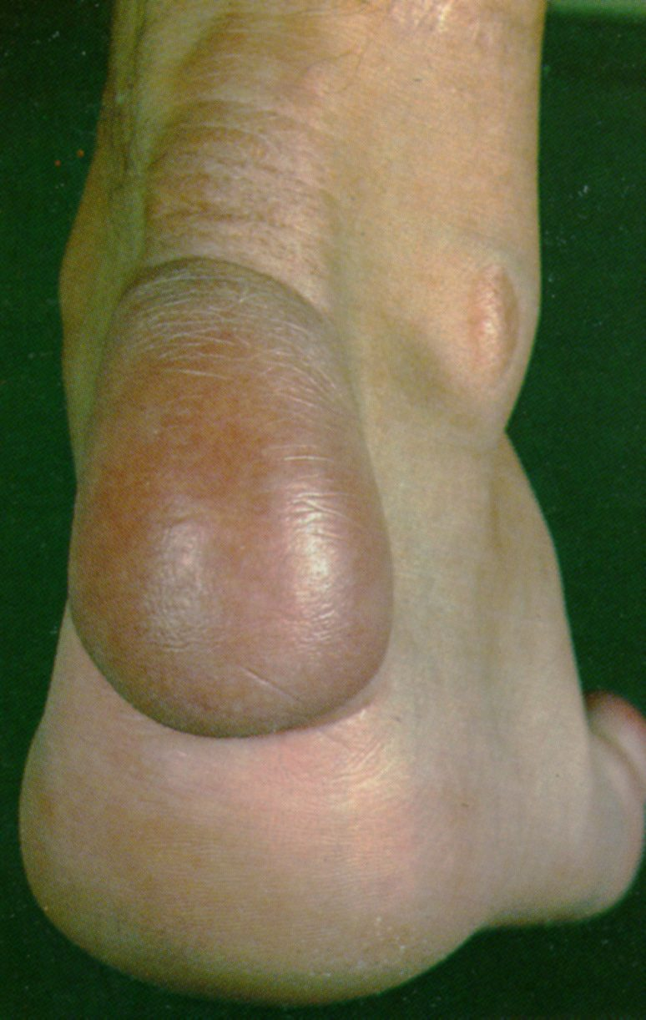
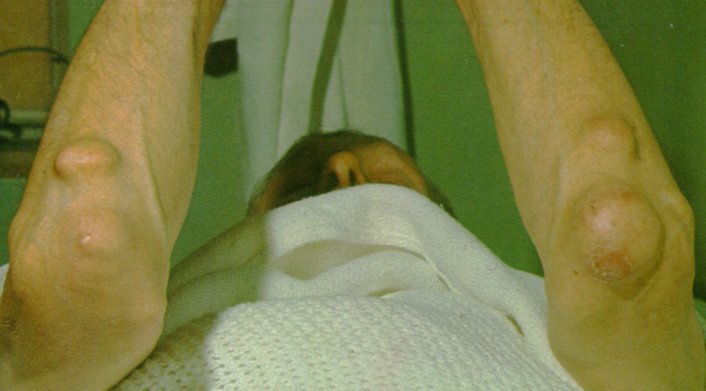
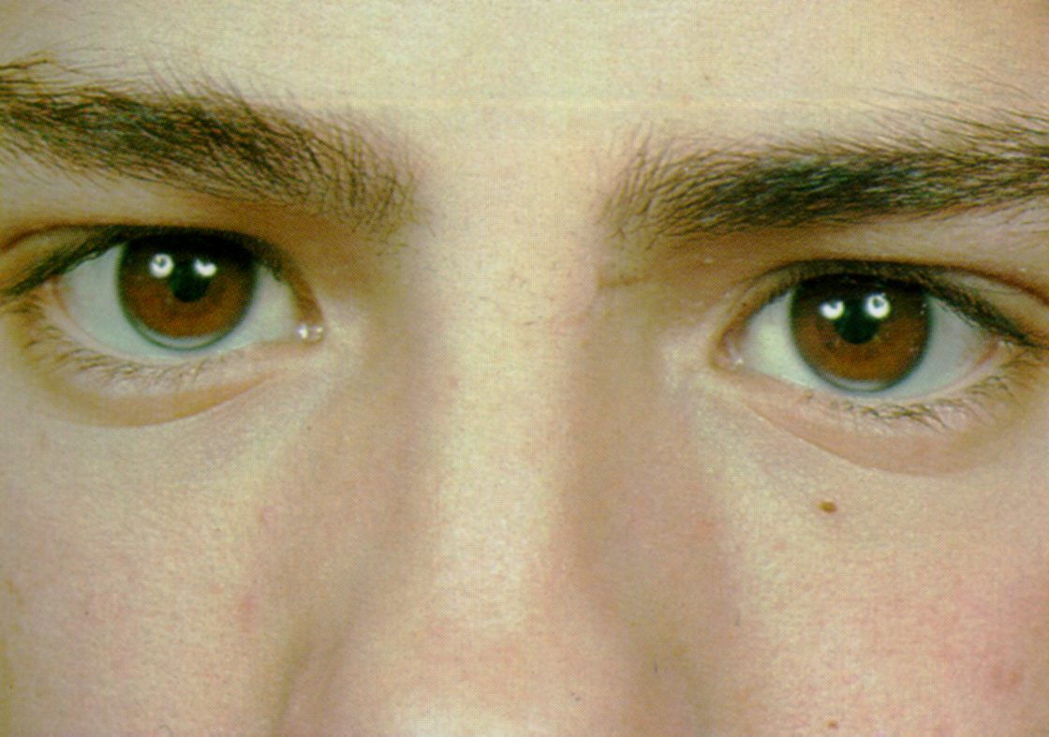

Slide 41
In HeFH, CAD develops in about 50% of males by the age of 50yrs and 30% of females by 60yr.
No specific diagnostic test.
Founder effect is demonstrated.( The loss of genetic variation that occurs when a new population is established by a very small number of individuals from a larger population).
Screening in target population was the initial method but changed to “cascade screening”.
Cascade screening- first and second degree relatives of diagnosed patients.
Various clinical criterias for diagnosis FH have been proposed.

Slide 42
Simon Broome criteria-UK
POSSIBLE | PROBABLE | DEFINITE
Total-cholesterol (LDL-C) in mg/dl >260(155) in patients with age <18 years and >290 (190) in patients >18 years F/H of elevated total-C >290 mg/dl in first or second degree relative or F/H of CAD at age <60 years in 1st degree relative or <50 years in 2nd degree relative | Total-cholesterol (LDL-C) in mg/dl >260(155) in patients with age <18 years and >290 (190) in patients >18 years Tendon xanthomas in the patient or in first/2nd degree relative | Total-cholesterol (LDL-C) in mg/dl >260(155) in patients with age <18 years and >290 (190) in patients >18 years DNA mutation consistent with FH

Slide 43
MEDPED criteria-USA
87%- sensitivity
98%- specificity

Slide 44
Dutch Lipid Clinic criteria

Slide 45
Screening of FH recommendations by US National Lipid association
Universal screening for elevated LDL-C or non-HDL-C is recommended.
FH should be suspected if children, adolescents, or young adults <20 years of age has LDL-C ≥160 mg/dl or non-HDL-C ≥190 mg/dl
LDL-C >190 in < 20 yr old group : 80% is Dx in general population screening.
F/H of elevated cholesterol/premature CAD among 1st degree relatives should be collected from the above mentioned group.
Positive family history increases the likelihood of diagnosis of FH
All individuals should be screened before the age of 20 years.
Screening should be considered beginning at the age of 2 years for children with family history of elevated cholesterol or premature coronary artery disease.
Tendon xanthoma at any age, arcus corneae at the age <45 years and xanthelasma at the age <25 years strongly suggest FH.

Slide 46
Management of FH
Target
National lipid association US & NICE- < LDL-C to 50%
Canadian & European guidelines LDL –C <116 in moderate risk group and < 70 in very high risk group
Life style modification must.
Pharmacological methods- multidrug approach may be needed.
First line drug -statins

Slide 47
Life style changes
Physical activity
Limitation of alcohol intake
Total avoidance of tobacco products
Low calorie diet with a total fat intake of ≤3% of the total dietary intake
<8% of saturated fat
<75 mg/1,000 kcal cholesterol for these patients

Slide 48
Familial Defective Apo-B-100 (FDB)
Dominantly inherited disorder (ADH type-2),less common than FH
Elevated plasma LDL levels with normal triglycerides, tendon xanthomas, increased incidence of premature ASCVD
Mutations in the LDL receptor–binding domain of apoB-100 is the defect.
LDL binds the receptor with reduced affinity -> removed from the circulation at a reduced rate
Clinically identical to HeFH but have lower plasma levels of LDL.
IDL clearance is not affected as IDL is cleared through Apo- E.

Slide 49
Autosomal Dominant Hypercholesterolemia -3
ADH –type 3 is a very rare autosomal dominant disorder caused by gain-of-function mutations in proprotein convertase subtilisin/kexin type 9 (PCSK9)
PCSK9 is a secreted protein that binds to the LDL receptor causing its degradation.
So gain of function mutation causes depletion in hepatic LDL-Receptor and LDL clearance reduced.
ADH –type 3 is indistinguishable clinically from patients with FH.
They may be particularly responsive to PCSK9 inhibitors like Alirocumab, Evolocumab.

Slide 51
Autosomal Recessive Hypercholesterolemia (ARH)
LDL Receptor Adaptor Protein (LDLRAP) is involved in LDL receptor–mediated endocytosis in the liver.
In the absence of LDLRAP, lipoprotein-receptor complex fails to be internalized.
Clinically resembles HoFH -Hypercholesterolemia, tendon xanthomas, premature CAD.
Hyperlipidemia responds partially to treatment with HMG-CoA reductase inhibitors
Usually require LDL apheresis to lower plasma LDL-C.
Notes:
LDL Receptor adaptor protein (LDLRAP)

Slide 52
Sitosterolemia
Rare Autosomal recessive disease.
It is caused by mutations in either of two members of the ATP-binding cassette (ABC) half transporter family, ABCG5 and ABCG8.
These genes are expressed in enterocytes and hepatocytes and are concerned with excretion of plant sterols across the membrane.
Due to this the hepatic & plasma level of plant sterols (sitosterol and campesterol) are increased and they down regulate the LDL –R in liver there by increasing the LDL-C.
Clinically-Severe hypercholesterolemia, tendon xanthomas, premature ASCVD (Atherosclerotic CardioVascular Disease)

Slide 53
Sitosterolemia
Anisocytosis and poikilocytosis of erythrocytes and megathrombocytes due to the incorporation of plant sterols into cell membranes.
Episodes of hemolysis and splenomegaly are a distinctive clinical feature and can be a clue to the diagnosis.
Sitosterolemia should be suspected
In a patient with severe hypercholesterolemia without a family history.
who responds dramatically to dietary therapy and/or ezetimibe/bile acid sequestrants but not statins.

Slide 54
Polygenic Hypercholesterolemia
Elevated LDL with a normal plasma level of triglyceride in the absence of secondary causes of hypercholesterolemia
Plasma LDL levels are generally not as elevated as they are in other primary hypercholesterolemias
Family studies to differentiate polygenic hypercholesterolemia from single-gene disorders.
Only <10% of fist degree relatives of patients with polygenic hypercholesterolemia have hypercholesterolemia.
Inheritance of several variants that together elevate LDLC, coupled with diet, is generally the cause of this condition
Notes:
One-half of the first-degree relatives of patients with FH and FDB are hypercholesterolemic, whereas <10% of first-degree relatives of patients with polygenic hypercholesterolemia have hypercholesterolemia
Treatment of polygenic hypercholesterolemia is identical to that of other forms of hypercholesterolemia

Slide 55
Lipoprotein(a)
Lp(a) (pronounced “lipoprotein little a”) consists of an LDL particle linked covalently with one molecule of apo (a).
The apo (a) moiety consists of a protein with a high degree of homology with plasminogen.
Apo (a) gene -6q26-27.
Several isoform, and the isoform with low molecular weight are more atherogenic.
The level of Lp(a) in a individual is completely genetically determined.
Higher conc. Seen in Africans, Asian have moderate level.
According to European Atherosclerosis Society(EAS) desirable level is <14mg/dl; >30 high risk.

Slide 56
Lipoprotein(a)
The Copenhagen City Heart Study- Lp(a)>50mg/dl →2-3 fold increased risk of MI.
Emerging Risk factor Collaborator data (n-133502)-Lp(a) reclassify 4.1% to high risk group.
The Bruneck study-(15yr prospective)39.6% reclassified as high risk on counting Lp(a) level.
Meta analysis of Erqou et al did not show linear association between Lp(a) level and coronay risk.
The INTERHEART study also not showed association.

Slide 57
Lipoprotein(a)
Current EAS guidelines on Lp(a) measurement
Premature CVD
Intermediate-high risk FH
F/H of premature CVD/increasd Lp(a) level
Recurrent CVD despite statsins
If >3% 10yr risk of fatal CVD by European guidelines
Treatment of choice- Niacin
But no clinical trial evidence that supports a benefit for lowering Lp(a).

Slide 58
Elevated small dense LDL particles
Associated with 3 fold ↑risk of CAD.
Low vitamin –E level
Increased sensitivity for oxidation
Easily enters vessel wall and initiate atherosclerosis
sd LDL has lower affinity to bind to LDL-R.
Higher conc. in insulin resistance.
Increase in sd LDL is called B pattern.
Life style modification and diabetic control can reverse LDL pattern from bad B pattern to good A pattern.
New concept is the number and size of LDL is more important than the plasma conc.

Slide 61
Combined dyslipedemia
Familial Combined Hyperlipidemia -FCHL (Type IIb Hyperlipoproteinemia)
Familial Dysbetalipoproteinemia –FDBL (Type III Hyperlipoproteinemia)
Hepatic Lipase Deficiency

Slide 62
Familial Combined Hyperlipidemia (FCHL)
Polygenic combined hyperlipidemia, incidence 1in 100-200.
The molecular etiology of this condition remains poorly understood.
Important cause of premature CAD
Approximately 20% of patients who develop CAD under age 60 have FCHL.
One of three phenotypes
Elevated plasma levels of LDL-C (200-400mg/dl) with low HDL-C.
Elevated plasma levels of triglycerides (200-600mg/dl)due to elevation in VLDL
Elevated plasma levels of both LDL-C and triglyceride
Classical feature of FCHL -lipoprotein profile can switch among these three phenotypes in the same individual over time
Disproportionate elevation in Apo-B relative to the plasma LDL-C ,due to small, dense LDL particles, is characteristic. (LDL-C/Apo-B=<1.2)
Family history of hyperlipidemia and/or premature CHD
Notes:
The presence of a mixed dyslipidemia
Plasma triglyceride levels between 200 and 800 mg/dL
Total cholesterol levels between 200 and 400 mg/dL
HDL-C levels <40 mg/dL in men and <50 mg/dL in women

Slide 63
Familial Dysbetalipoproteinemia –FDBL (Type III Hyperlipoproteinemia)
Mixed hyperlipidemia due to the accumulation of remnant lipoprotein particles (chylomicron remnants and VLDL remnants, or IDL).
Due to genetic variations in apoE isoforms
Patients homozygous for the E2 allele (the E2/E2 genotype) comprise the most common subset of patients with FDBL
The plasma levels of cholesterol and TG are often elevated to a similar degree.
Precipitating factors usually present (high-fat diet, diabetes mellitus, obesity, hypothyroidism, renal disease, HIV infection, estrogen deficiency, alcohol use, drugs)
Notes:
high-fat diet, diabetes mellitus, obesity, hypothyroidism, renal disease, HIV infection, estrogen deficiency, alcohol use, drugs

Slide 64
Familial Dysbetalipoproteinemia (Type III Hyperlipoproteinemia)
Hyperlipidemia, xanthomas, premature CAD or PAD.
Two pathagnomonic types of xanthomas- tuberoeruptive and palmar, are seen in FDBL patients.( xanthomata striata palmaris)
The ratio of directly measured VLDL-C to total plasma TG >0.30.
The disease seldom presents in women before menopause
Broad beta band on electrophoresis
Dramatic response to weight reduction and dietary changes; statins
Treatment of other metabolic conditions
Notes:
Palmar xanthomas (alternatively called xanthomata striata palmaris) are orange-yellow discolorations of the creases in the palms and wrists
In FDBL, in contrast to other disorders of elevated triglycerides, the plasma levels of cholesterol and triglyceride are often elevated to a similar degree and the level of HDL-C is usually normal rather than being low

Slide 66
Hepatic Lipase Deficiency
Autosomal recessive disorder, very rare
Elevated plasma levels of cholesterol and triglycerides (mixed hyperlipidemia) due to the accumulation of circulating lipoprotein remnants.
Association of this genetic defect with ASCVD is not clearly known.
Lipid-lowering therapy with statins along with other drugs.
Notes:
and either a normal or elevated plasma level of HDL-C

Slide 67
Lipid Disorders Associated with Elevated Triglycerides
Familial Chylomicronemia Syndrome (Type I Hyperlipoproteinemia; Lipoprotein Lipase and ApoC-II Deficiency)
Familial Hypertriglyceridemia (Type IV &V)
Apo A-V Deficiency
GPIHBP1 Deficiency

Slide 68
Familial Chylomicronemia Syndrome
LPL (Lipoprotein Lipase) is required for the hydrolysis of triglycerides in chylomicrons and VLDLs
ApoC-II is a cofactor for LPL.
Genetic deficiency or inactivity of LPL or apo C II results in impaired lipolysis and elevations in plasma chylomicrons.
The fasting plasma is turbid.
Fasting TG levels are almost invariably >1000 mg/dL.
IV heparin injection - endothelial-bound LPL is released
LPL activity is profoundly reduced in both LPL and apo C-II deficiency
Normalizes after the addition of normal plasma (providing a source of apoC-II)

Slide 69
Familial Chylomicronemia Syndrome
Very rare, AR in inheritance
Recurrent abdominal pain in childhood –acute pancreatitis.
Lipemia retinalis, Eruptive xanthomas- small, yellowishwhite papules, often appear in clusters on the back, buttocks, and extensor surfaces of the arms and legs.
Premature CHD is not generally a feature of familial chylomicronemia syndromes.
Hepatosplenomegaly may be seen
Dietary fat restriction with fat-soluble vitamin supplementation
Medium-chain triglycerides
Fish oils,Fresh frozen plasma – source of apo C
Plasmapheresis in pregnancy &Gene therapy-alipogene tiparvovec is approved.

Slide 71
Familial Hypertriglyceridemia (FHTG)
Polygenic hypertriglyceridemia.
Plasma LDL-C levels are generally not increased and are often reduced due to defective metabolism of the triglyceride-rich particles.
The diagnosis of FHTG is suggested by the triad of
Elevated levels of plasma triglycerides (250–1000 mg/dL)
Normal or only mildly increased cholesterol levels (<250 mg/dL)
Reduced plasma levels of HDL-C
Secondary factors are to be ruled out first.
VLDL is elevated & Unlike FCHL Apo B levels not elevated
There is no increased risk of CAD but pancreatitis risk is there

Slide 72
HYPERTRIGLYCERIDEMIA - OTHER CAUSES
APO A V DEFICIENCY
Apo A-V required for the association of VLDL and chylomicrons with LPL
Deficiency presents as hyperchylomicronemia
GPIHBP1 Deficiency
LPL is attached to a protein on the endothelial surface of capillaries called GPIHBP1
Mutations that interfere with GPIHBP1 synthesis or folding cause severe hypertriglyceridemia

Slide 73
Inherited Causes of Low Levels of Apo B Containing Lipoproteins
Familial Hypobetalipoproteinemia (FHB)
Most common inherited form of hypocholesterolemia
Low total cholesterol and LDL-C due to mutations in apoB
LDL levels < 80 mg%.
Protection from CHD.
Parents have abnormal lipid fractions.

Slide 74
PCSK9 Deficiency
Loss of function mutations
PCSK9 normally promotes the degradation of the LDL receptor
Absence cause increased activity of LDL receptor and low LDL levels ( 40% reduction)
Protection from CHD increases as plasma LDL levels decrease
Notes:
Phenocopy of FHB

Slide 75
Abetalipoproteinemia
AR disorder due to loss-of-function mutations in the gene encoding microsomal triglyceride transfer protein (MTP)
MTP -transfers lipids to nascent chylomicrons and VLDLs in the intestine and liver
Parents have normal lipid levels
Diarrhea and failure to thrive
Neurologic manifestations
Pigmented retinopathy -defective absorption and transport of fat soluble vitamins – vitamin E
Low-fat, high-caloric, vitamin-enriched diet

Slide 76
Genetic Disorders of HDL Metabolism
Inherited causes of low levels of HDL-C
Gene Deletions in the Apo A V-AI-CIII-AIV Locus and Coding Mutations in ApoA-I
Tangier Disease (ABCA1 Deficiency)
LCAT Deficiency
Primary Hypoalphalipoproteinemia
Inherited causes of high levels of HDL-C
CETP Deficiency

Slide 77
Gene Deletions in the ApoAV-AI-CIII-AIV Locus and Coding Mutations in ApoA-I
Absence of mature HDL
Free cholesterol increase in HDL and in tissues
Corneal opacities and planar xanthomas
Premature CHD

Slide 78
Tangier Disease (ABCA1 Deficiency)
Autosomal recessive
ABCA1, a cellular transporter that facilitates efflux of unesterified cholesterol and phospholipids from cells to apoA-I
Extremely low circulating plasma levels of HDL-C (<5 mg/dL) and apoA-I (<5 mg/dL).
Hepatosplenomegaly, pathognomonic enlarged grayish yellow or orange tonsils, mononeuritis multiplex
Premature CHD not so common – because LDL levels also low

Slide 79
LCAT Deficiency
Autosomal recessive
Defective formation of mature HDL
Low levels of HDL
2 types – complete (Classic)and partial( Fish-eye disease)
Progressive corneal opacification -charcteristic
Fish eye disease has no other sequelae.
Complete form – hemolytic anemia, progressive renal insufficiency and ESRD
Premature CAD not seen

Slide 80
Primary Hypoalphalipoproteinemia (Isolated low HDL Syndrome)
Defined as a plasma HDL-C level below the tenth percentile in the setting of relatively normal cholesterol and triglyceride level
No apparent secondary causes of low plasma HDL-C
No clinical signs of LCAT deficiency or Tangier disease.
Premature CHD not a consistent feature
Notes:
Premature CHD depends on gene defect and other underlying metabolic defects

Slide 81
Inherited causes of high levels of HDL-C
CETP DEFICIENCY
Loss-of-function mutations
CETP facilitates transfer of cholesteryl esters from HDL to apoB-containing lipoproteins
CETP deficiency results in an increase in the cholesteryl ester content of HDL,decreased clearance of HDL and a reduction in plasma levels of LDL-C
The relationship of CETP deficiency to ASCVD remains unresolved

Slide 83
Laboratory assessment
If suspecting FH better to check FLP at the age of 2 years, then at 7-11years.
Nonfasting lipid panel
measures HDL and total cholesterol
Fasting lipid panel
Measures HDL, total cholesterol and triglycerides
LDL cholesterol is calculated:
LDL cholesterol = total cholesterol – (HDL + triglycerides/5)

Slide 84
Friedewald Calculation
LDL cholesterol = total cholesterol – (HDL + triglycerides/5)
When TG level very high friedwald calculation is not applicable.
When the calculated LDL-C <100 the error factor increases with friedwald calculation
If LDL-C is measured directly fasting is not required.

Slide 85
TREATMENT
Lifestyle changes
Drugs
Lipoprotein apheresis
Gene therapy

Slide 86
Diet

Slide 90
Exercise recommendation
Exercise→ Recommended target for improvements in blood lipid profile is minimum of 1,000 kcal/week.
Strategy is to maximize energy expenditure
Mode- Aerobic exercise.
Intensity- should be between 40-70% of VO2 Reserve or Heart Rate Reserve.
Frequency and Duration--30-60 minutes, at least 5 times per week.

Slide 91
Management of FH
Target
National lipid association US & NICE- < LDL-C to 50%
Canadian & European guidelines LDL –C <116 in moderate risk group and < 70 in very high risk group
Life style modification must.
Pharmacological methods- multidrug approach may be needed.

Slide 92
Life style modification
Physical activity
Limitation of alcohol intake
Total avoidance of tobacco products
Low calorie diet with a total fat intake of ≤3% of the total dietary intake
<8% of saturated fat
<75 mg/1,000 kcal cholesterol for these patients

Slide 93
Treatment of HoFH
The NICE UK guideline.
LDL apheresis combined with maximum tolerated potent statins, ezetimibe and bile acid sequestrants.
Apheresis should start in early childhood after initiation of drug treatment.

Slide 94
LDL apheresis
In HoFH, hyperLp(a)
Does once in two week
Indication
Pts with max tolerated drug therapy and have CAD and LDL-C >200mg/dl.
No CAD wit plasma LDL-C >300mg/dl

Slide 96
Inhibitors of LDL synthesis, lomitapide and mipomersen, are new therapeutic options. PCSK9 inhibitors are being evaluated in HoFH and seem to be effective if there is residual receptor activity.

Slide 97
Lomitapide
Approved for the treatment of HoFH
US FDA approved lomitapide on 21 December 2012.
It is an orphan drug.
MOA- Microsomal triglyceride transfer protein inhibitor(MTP inhibitor)
↓LDL-C by 50% and prevent VLDL formation and secretion from liver.
↑ALT level and fatty liver.

Slide 98
Mipomersen
Mipomersen inhibit apo B mRNA with phosphorothioate-linked antisense oligonucleotides.
Approved for HoFH.
↓LDL-C by 20-30%.
S.E-Associated with fat deposition in the liver

Slide 99
Management of Hypertriglyceridemia/ Chylomicronemia
NCEP ATP III classification
150 to 199 mg/dL → borderline
200 to 499 mg /dL →high
>500 mg/dl →very high.
Patients with elevated fasting triglyceride levels should be evaluated for secondary causes of hyperlipidemia and treated accordingly.
Excessive alcohol intake,
Untreated diabetes,
Endocrine conditions,
Renal or liver disease,
Pregnancy,
Autoimmune disorders,
Medications (e.g., thiazides, beta blockers, estrogen, isotretinoin, corticosteroids, bile acid–binding resins, antiretroviral protease inhibitors, immunosuppressants, antipsychotics).

Slide 100
Dietary fat restriction with fat-soluble vitamin supplementation.
Dietary simple carbohydrates restriction.
Medium-chain triglycerides
Fresh frozen plasma – source of apo C deficiency.
Fibrates, niacin, fish oils and statins in combination.
Fibrates are the first-line treatment in patients with hypertriglyceridemia who are at risk of pancreatitis.
Plasmapheresis in pregnancy
Gene therapy-alipogene tiparvovec is approved.

Slide 101
Specific treatment
Sitosterolemia→ Ezetimibe, BAS.
Lp(a)→Niacin
ADH-type 3(gain-of-function mutations of PCSK9)→ Alirocumab, Evolocumab.

Slide 103
Statins
Statins- inhibitors of HMG-CoA reductase and prevent the formation of mevalonate, the rate-limiting step of sterol synthesis.
Increases hepatic LDL –R and decrease the production of VLDL and LDL.
Statins may increase HDL-C.
Statins decrease the inflammatory component of plaque.
Statins ↑Trans Intestinal Cholesterol Excretion(TICE).
S.E- Myalgia(10%),myositis(↑CPK, need rechallenge to confirm),rhabdomyolysis(rare),reversible elevation of ALT.
Check ALT and CPK within 3months.
Usually well tolerated.

Slide 104
Biliary cholesterol excretion & TICE

Slide 105
Evidence for statin therapy

Slide 106
ACC/AHA Release Updated Guideline on the Treatment of Blood Cholesterol to Reduce ASCVD Risk-2014
Key Points for Practice
The guideline emphasizes that lifestyle modification remains a critical component of ASCVD reduction.
Four groups most likely to benefit from statin therapy are identified:
Patients with any form of clinical ASCVD
Patients with primary LDL-C levels of 190 mg per dL or greater
Patients with diabetes mellitus, 40 to 75 years of age, with LDL-C levels of 70 to 189 mg per dL
Patients without diabetes, 40 to 75 years of age, with an estimated 10-year ASCVD risk ≥ 7.5%
Risk assessment for 10-year and lifetime risk is recommended using an updated ASCVD risk calculator: http://my.americanheart.org/ cvriskcalculator.

Slide 107
High intensity - Daily dosage lowers LDL-C by approximately ≥ 50% on average
Moderate intensity -Daily dosage lowers LDL-C by approximately 30% to 50% on average
Low intensity -Daily dosage lowers LDL-C by < 30% average.
Statins are first line treatment option in almost all condition with hypercholesterolemia( primary /secondary).
Statin therapy is not routinely recommended for individuals with NYHA class II to IV HF(GISSI, CORONA study) or who are receiving MHD.

Slide 110
Ezetimibe
Ezetimibe limits selective uptake of cholesterol and other sterols by intestinal epithelial cells by interfering with NPC1L1 (Niemann–Pick C1–like 1).
Usual second line agent, Dose 10 mg
Ezetimibe lowers LDL-C by about 18% and adds to the effect of statins.
Drug of choice in cases of sitosterolemia.
Ezetimibe trials-ENHANCE,SEAS,ARBITER-6,SHARP & IMPROVE-IT

Slide 111
Ezetimibe Evidence: Efficacy at Reducing LDL-C
892 patients with primary hypercholesterolemia randomized to ezetimibe (10 mg) or placebo for 12 weeks
LDL-C
HDL-C
Triglycerides
+5.7
+5
+1.3
+0.4
0
–1.6
–5
Mean % change from baseline to week 12
–5.7
–10
Placebo
Ezetimibe 10 mg
–15
–16.9*
–20
*p<0.01 compared to placebo
HDL-C=High density lipoprotein cholesterol, LDL-C=Low density lipoprotein cholesterol
Source: Dujovne CA et al. Am J Cardiol 2002;90:1092-1097
Notes:
111
This slide presents data from a phase III clinical trial of 892 patients with primary hypercholesterolemia randomized to ezetimibe (10 mg) or placebo for 12 weeks. Ezetimibe reduced levels of LDL-cholesterol by 16.9%, compared with an increase of 0.4% with placebo (p<0.01). Ezetimibe also significantly (but modestly) increased levels of HDL-C and decreased levels of triglycerides as compared to placebo. No randomized trials powered for clinical outcomes have been published yet.
A surrogate endpoint trial, ENHANCE, involved 720 patients with heterozygous familial hypercholesterolemia who were randomly assigned to treatment with simvastatin (80 mg daily) with or without ezetimibe (10 mg daily). Decreases in LDL-C were greater in patients treated with combination therapy (56 versus 39 percent) as were increases in HDL-C (10 versus 8 percent). Despite the large additional reduction in LDL-C with ezetimibe, there was no statistically significant difference in the primary outcome of change from baseline in carotid intima-media thickness (0.0111 versus 0.0058 mm, p=0.29) after 2 years. There is some controversy, however, in how the IMT was measured. There did not appear to be a difference between the two arms in the small number of cardiovascular events seen in the trial (10 versus 7 events).
In the SEAS trial (a study evaluating ezetimibe in aortic stenosis), patients randomized to ezetimibe had an increased rate of reported cancers. An interim analysis of two other trials evaluating simvastatin and ezetimibe (IMPROVE-IT and SHARP) found no increased risk of incident cancer but a trend toward an increase in cancer deaths.

Slide 118
Fibrates
Indicated for hypertriglyceridemia and in the secondary prevention of CVD in patients with low HDL-C levels.
Gemfibrozil 600mg BD, Fenofibrate 200mg OD.
MOA-interact with PPAR-α, which regulates transcription of the LPL, apo C-II, and apo A-I genes.
S.E-cutaneous manifestations,abdominal discomfort, increased bile lithogenicity, erectile dysfunction, elevated transaminase levels, interaction with oral anticoagulants, and elevated plasma homocysteine.
In post statin era the FIELD and ACCORD trials have failed to achieve clinical usefulness of fibrates.

Slide 124
Bile Acid Sequestrant
Interrupt the enterohepatic circulation of bile acids by inhibiting their reabsorption.
Used as adjunctive therapy
Not absorbed systemically, safest
Cholestyramine - 4-g unit doses as a powder
Colestipol is used in 5-g unit doses.
Colesevelam is more potent,twice the capacity to bind cholesterol as cholestyramine does.( In doses of 3.8 to 4.5 g/day)
Colesevelam decrease glycated hemoglobin A1c (HbA1c).
Taken with food, other medication 1hr b/f or 4hr after only.
S.E- constipation, a sensation of fullness, and gastrointestinal discomfort.
Can cause hypertriglyceridemia.

Slide 125
Bile Acid Sequestrant Evidence: Primary Prevention
Lipid Research Clinics-Coronary Primary Prevention Trial (LRC-CPPT)
3,806 men with primary hypercholesterolemia randomized to cholestyramine (24 grams) or placebo for 7.4 years
A bile acid sequestrant provides benefit in those with high cholesterol levels
19% RRR
9
8.6
7.0
6
Rate of MI or CHD death (%)
3
P<0.05
0
Placebo
Cholestyramine
CHD=Coronary heart disease, MI=Myocardial infarction, RRR=Relative risk reduction
Source: The LRC-CPPT Investigators. JAMA 1984;251:351-364
Notes:
125
The Lipid Research Clinics-Coronary Primary Prevention Trial (LRC-CPPT) randomized 3,806 men with primary hypercholesterolemia to cholestyramine (24 grams) or placebo for 7.4 years. Levels of LDL-C and total cholesterol were reduced by 20.3% and 13.4% in the cholestyramine arm, respectively, resulting in a 12.6% and 8.5% greater reduction than that seen in the placebo group.
The risk of the primary end point (coronary heart disease death or nonfatal MI) was reduced by 19% in the cholestyramine group. This trial led to the concept that every 1% decrease in total cholesterol results in a 2% reduction in coronary events.

Slide 126
Nicotinic acid
Niacin ↑HDL-C,↓ TG levels & ↓VLDL production.
Modest effects on LDL levels.
Doses- 2000 to 3000 mg/day TID.
S.E-Skin flushing, attenuated by aspirin & prostaglandin D2 receptor antagonist laropiprant.
Other S.E- Hyperuricemia, Hyperglycemia, Hepatotoxicity, Acanthosis nigricans, and gastritis.
The mechanism of action of niacin remains unsettled.
Large clinical trials do not support the ability of niacin therapy to improve cardiovascular outcomes in patients receiving statins.

Slide 127
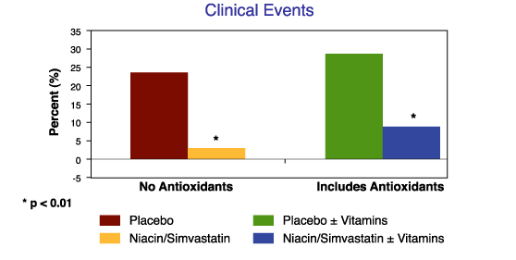
Nicotinic Acid Evidence: Secondary Prevention
HDL-Atherosclerosis Treatment Study (HATS)
160 men with CAD, low HDL-C, and normal LDL-C randomized to simvastatin (10-20 mg) + niacin (1000 mg bid), simvastatin (10-20 mg) + niacin (1000 mg bid) + antioxidants, or placebo for 3 years
A statin plus niacin provides benefit to men with CAD and low HDL-C levels
*
**
**
Placebo (n=34)
Placebo + Vitamins (n=39)
Niacin/Simvastatin (n=33)
Niacin/Simvastatin + Vitamins (n=40)
*Includes cardiovascular death, MI, stroke, or need for coronary revascularization
**p<0.01, but low absolute event rates
CAD=Coronary artery disease, HDL-C=High density lipoprotein cholesterol, LDL-C=Low density lipoprotein cholesterol
Source: Brown BG et al. NEJM 2001;345:1583-1592
Notes:
127
The HDL Atherosclerosis Intervention Trial (HATS) was a 3-year randomized, double-blind study of 160 patients with coronary artery disease, low HDL-C levels, and normal LDL-C levels. Patients were randomly assigned to treatment with one of four therapies, including simvastatin (10-20 mg daily) + niacin (1000 mg twice daily), simvastatin (10-20 mg daily) + niacin (1000 mg twice daily) + antioxidants, antioxidants, or placebo.
Clinical events (cardiovascular death, myocardial infarction, stroke, or revascularization) occurred in 3% of simvastatin + niacin patients, 14% of simvastatin + niacin + antioxidant patients, and 24% of placebo patients. In addition, coronary stenosis on angiography progressed by 3.9% with placebo and by 0.7% with simvastatin + niacin + antioxidants (P=0.004). In contrast, the average stenosis regressed by 0.4% with simvastatin + niacin alone (P<0.001).

Slide 131
Omega-3 Fatty Acids Evidence(fish oil)
: Primary and Secondary Prevention
Japan Eicosapentaenoic acid Lipid Intervention Study (JELIS)
18,645 patients with hypercholesterolemia randomized to EPA (1800 mg) with a statin or a statin alone for 5 years
Omega-3 fatty acids provide CV benefit, particularly in secondary prevention
The primary endpoint
of any major coronary
event was reduced
from 3.5% in the
statin alone group
to 2.8% in the
EPA + statin group
Years
*Composite of cardiac death, myocardial infarction, angina, PCI, or CABG
CV=Cardiovascular, EPA=Eicosapentaenoic acid
Source: Yokoyama M et al. Lancet 2007;369:1090-1098
Notes:
131
The JELIS trial randomized 18,645 hypercholesterolemic patients in Japan to receive either 1800 mg of EPA daily with a statin (EPA group; n=9326) vs. a statin alone (controls; n=9319). After a 5-year follow-up, the primary endpoint of any major coronary event was reduced from 3.5% in the statin alone group to 2.8% in the EPA + statin group (RRR 19% p=0.011). In patients with no history of coronary artery disease, EPA treatment reduced major coronary events by 18%, but this finding was not significant (1.4% in the EPA group vs 1.7% in the control group; p=0.132).

Slide 132
Dietary Adjuncts Evidence: Efficacy at Reducing LDL-C
Therapy | Dose (g/day) | Effect
Dietary soluble fiber | 5-10 (psyllium) | ↓ LDL-C 10-15%
Soy protein | 20-30 | ↓ LDL-C 5-7%
Stanol esters | 1.5-2 | ↓ LDL-C 15-20%
LDL-C=Low density lipoprotein cholesterol
Sources:
Kwiterovich Jr PO. Pediatrics 1995;96:1005-1009
Lichtenstein AH. Curr Atheroscler Rep 1999;1:210-214
Miettinen TA et al. Ann Med 2004;36:126-134
Notes:
132
A healthy diet, that includes increased amounts of whole grains, fiber, fruits, vegetables, soy protein, and stanol esters, can significantly reduce levels of LDL-C.

Slide 133
PCSK9 inhibitors
Monoclonal antibodies that inhibit proprotein convertase subtilisin–kexin type 9 (PCSK9) have emerged as a new class of drugs that effectively lower LDL cholesterol levels.
Evolocumab, alirocumab.
Injectables 2weekly or monthly
Can reduce LDL –C upto 60% from baselines.
Trials supporting GAUSS-2, RUTHERFORD-2, LAPLACE-2, DESCARTES, and TESLA Part B
The latest is FOURIER Trial -2017

Slide 134
FOURIER Clinical Trial
CONCLUSIONS
In this trial, inhibition of PCSK9 with evolocumab on a background of statin therapy
lowered LDL cholesterol levels to a median of 30 mg per deciliter (0.78 mmol per liter)
and reduced the risk of cardiovascular events. These findings show that patients with
atherosclerotic cardiovascular disease benefit from lowering of LDL cholesterol levels
below current targets.

Slide 138
CETP inhibitors
Cholesteryl Ester Transfer Protein Inhibitors
↑HDL-C (138%) and ↓LDL-C (40%)
Torcetrapid →ILLUMINATE trial-proved toxic and increased mortality hence abandoned.
Dalcetrapid→dal-OUTCOMES trial-found ineffective.
Anacetrapib
DEFINE trial- phase II clinical trial good results.
REVEAL trial ongoing
Evacetrapib →ACCELERATE trial-going on

Slide 139
Effect of Pharmacotherapy
on Lipid Parameters
Therapy
TC
LDL-C
HDL-C
TG
Patient tolerability
Statins
- 19-37%
- 25-50%
+ 4-12%
- 14-29%
Good
Ezetimibe
- 13%
- 18%
+ 1%
- 9%
Good
Bile acid sequestrants
- 7-10%
- 10-18%
+ 3%
Neutral or ­
Poor
Nicotinic acid
- 10-20%
- 10-20%
+ 14-35%
- 30-70%
Reasonable to Poor
Fibrates
- 19%
- 4-21%
+ 11-13%
- 30%
Good
Daily dose of 40mg of each drug, excluding rosuvastatin
HDL-C=High-density lipoprotein cholesterol, LDL-C=Low-density lipoprotein cholesterol, TC=Total cholesterol, TG=Triglyceride
Notes:
139
Lipid-modifying therapies include HMG CoA reductase inhibitors (statins), fibrates, bile acid sequestrants (resins), nicotinic acid (and its derivatives), and ezetimibe.
Statins are highly effective at lowering LDL-cholesterol levels and have a good tolerability profile.¹⁻³ Data presented in this slide does not include rosuvastatin.
Bile acid sequestrants are potent cholesterol-modifying agents. Adverse events such as gastrointestinal bloating, nausea and constipation limit compliance to bile acid sequestrants.^{1,2}
Nicotinic acid, a B vitamin, is effective at reducing both LDL cholesterol and triglyceride concentrations, and increasing HDL cholesterol levels. To be effective, it must be given in pharmacologic doses. The value of nicotinic acid has been limited by the incidence of adverse events, which include flushing, gastrointestinal distress, liver toxicity, hyperglycemia. and hyperuricemia.^{1,2}
Fibrates are effective at lowering triglyceride levels and raising HDL-C levels. However, in a majority of patients they are only moderately successful in reducing LDL-cholesterol.^{1,2}
Ezetimibe is the first of a novel class of selective cholesterol-absorption inhibitors. Ezetimibe may be useful in patients that are intolerant of other lipid-modifying therapies and in combination with a statin in patients that are intolerant of large doses of statins or need further reduction in LDL cholesterol despite the maximum dose of a statin.⁴
References:
1. Yeshurun D, Gotto AM. Southern Med J 1995;88(4):379–391.
2. National Cholesterol Education Program. Circulation 1994;98(3):1333–1445.
3. Knopp RH. N Engl J Med 1999;341:498–511.
4. Gupta EK, Ito MK. Heart Dis 2002;4:399–409.

Slide 140
Gene therapy
In patients with HoFH initial trials were not successful.
But it is found to be effective in
Abetalipoproteinemia,
LPL deficiency,
Niemann-Pick type C disease,
Sitosterolemia,
Tangier disease.

Slide 141
Thank you

